Slide 1
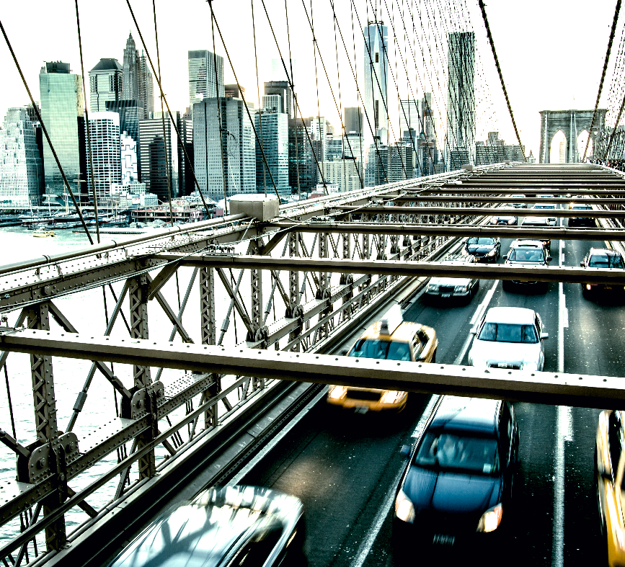

Automated Cars for Safety and Efficiency Applications and potential
March 31st, 2023

Slide 2
Contents
Overview 3
Current State of Autonomous Cars 4
Advantages and Opportunity Areas 5
Understanding the Data 6
Safety and Reliability 7
What’s Next? 8
Conclusions, Q/A 9

Slide 3
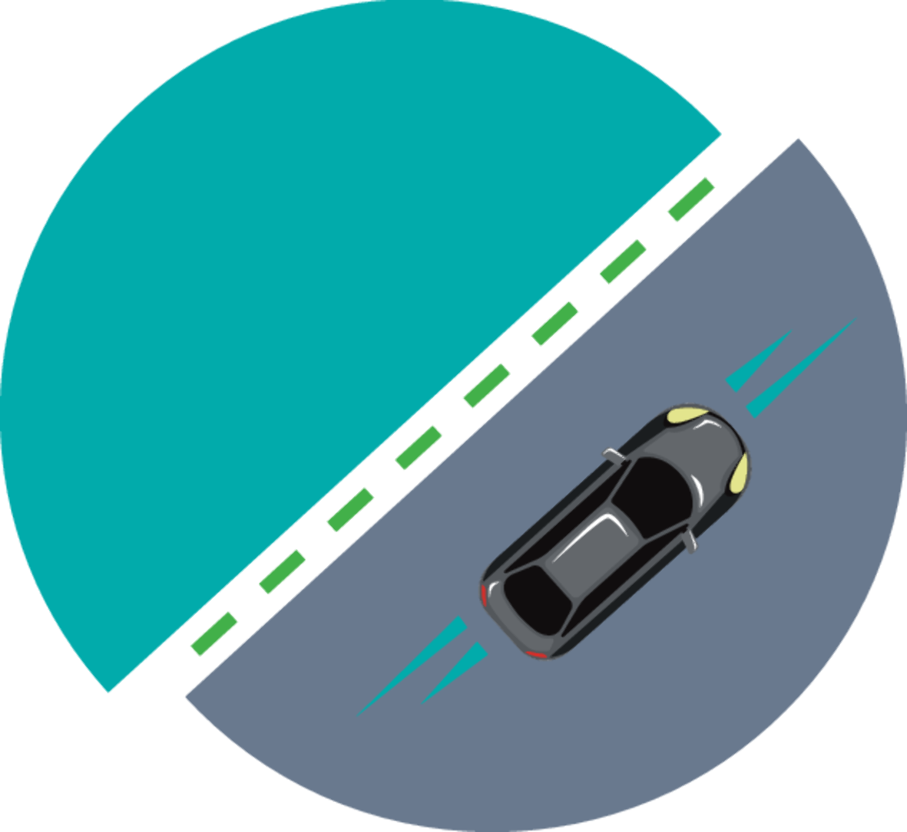
Overview
Autonomous Cars
Autonomous cars represent the next disruption in the transportation sector
More efficient traffic distribution and movement
Human Factor is removed
Profitable because of AI

Slide 4
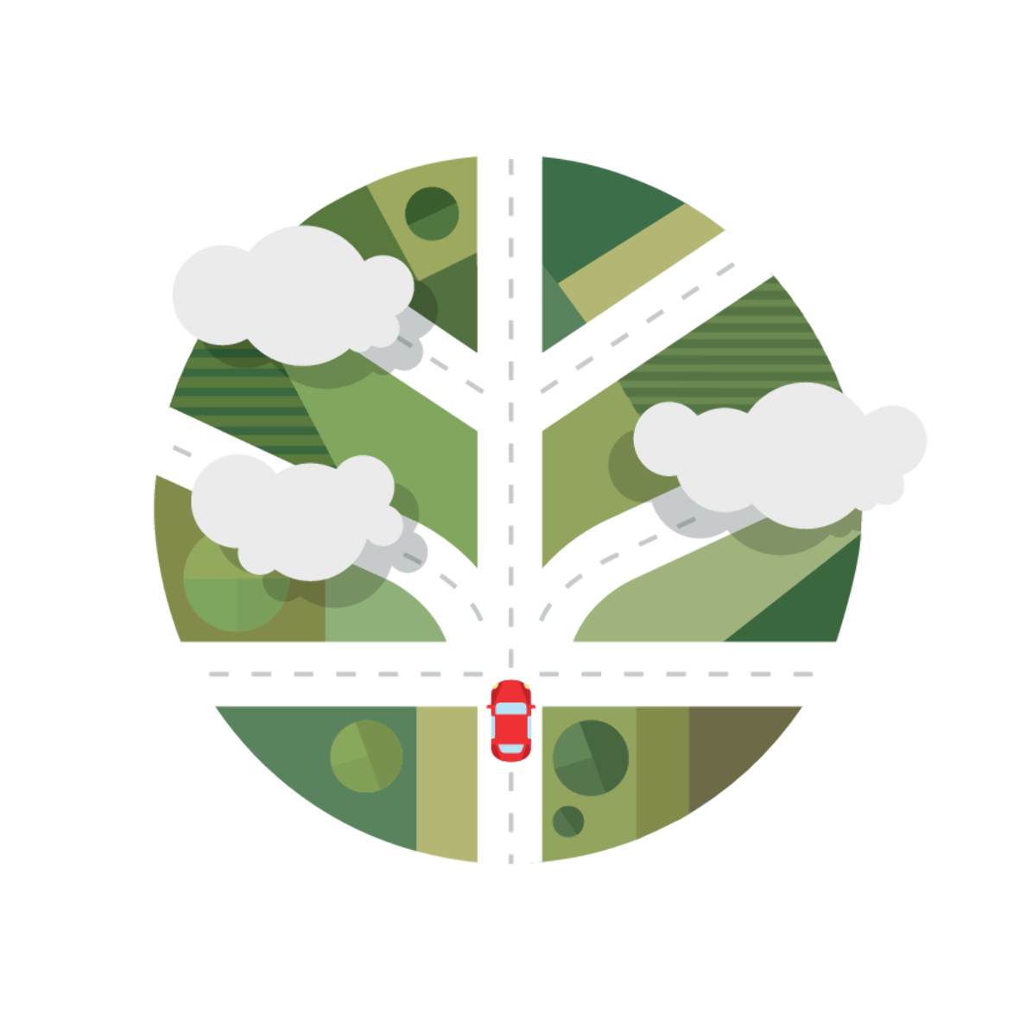
Current State of Autonomous Cars
Driver Assistance
Vehicle features a single automated system,
i.e. Speed monitoring through cruise
Partial Automation
The vehicle can steer and accelerate, the human monitors and controls all tasks
Most companies are at this level
ADAS
Conditional Automation
Environmental detection capabilities
Vehicle can perform most driving tasks, human override is required
High Automation
Vehicle performs all tasks under specific circumstances
Human override is optional
Full Automation
Vehicle performs all tasks under all conditions
No human interaction is required

Slide 5
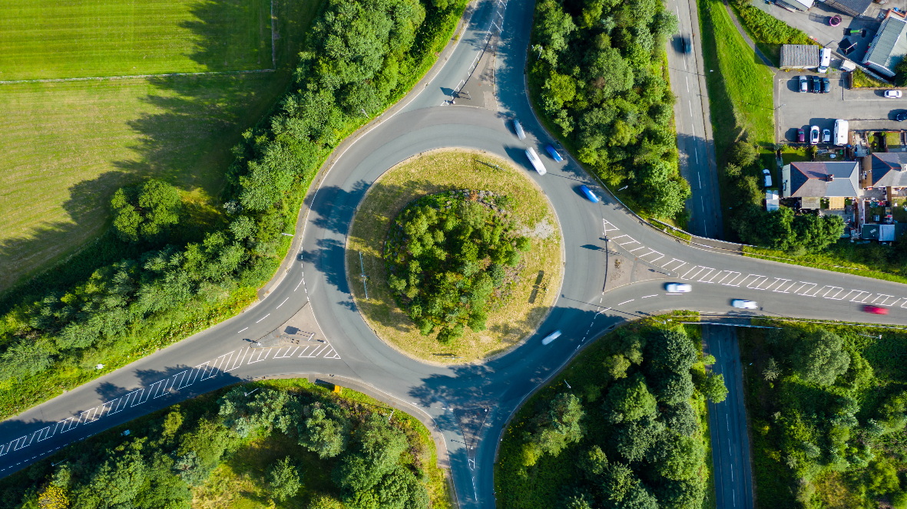
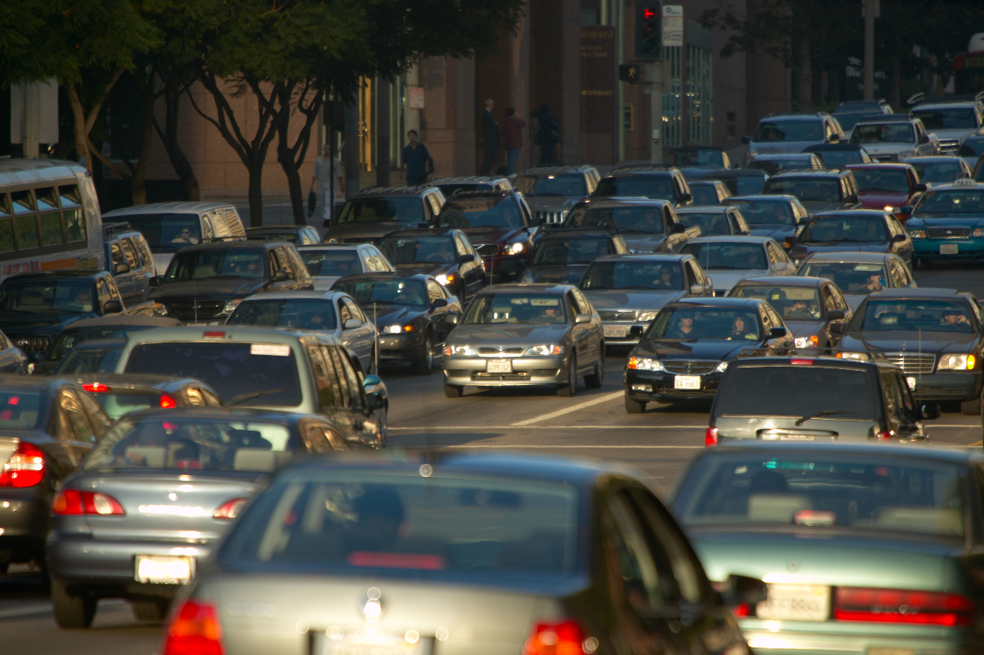
Advantages and Opportunity Areas
1.3 Million Annual deaths prevention
Reduced emissions
Less traffic
Level five is the fourth level of bullets
Decreased unproductive and stressful driving time
Failure to predict situations may lead to tragedy
Moral dilemma
Further development is needed

Slide 6
Understanding the Data
Topic | Columns | Concern to address | Methodology
ADAS / ADS / Other
Car Accidents | Report ID Date Car brand Level of Driving Automation Mileage | Safety Concerns Reliability | Logistic Regression Decision Trees
Traffic Congestion
Car Accidents | Report ID Date Car brand Level of Driving Automation Mileage | Environment Recognition | Neural Networks

Slide 7

Safety and Reliability
Autonomous Cars
Major concerns related to automated cars are related to how safe they may be.
During the same period of time, there were more car accidents involving vehicles where the driver was human than a machine.
Machines can be programmed and have the ability to plan and react without being affected by emotions.
Car accidents by Automation Level
Source:
Note:

Slide 8

What’s Next?
The future
Self-driving vehicles require a good understanding of the environment and the dynamics of traffic behavior and adaptability
Convolutional Neural Networks (CNN) this is dummy text it is not here to be read it is here to show how this document will look.
IoT, connectivity between autonomous cars would prove to be a huge leap towards smarter transportation.

Slide 9
Conclusions
Q / A

Slide 10
About Deloitte Deloitte refers to one or more of Deloitte Touche Tohmatsu Limited, a UK private company limited by guarantee (“DTTL”), its network of member firms, and their related entities. DTTL and each of its member firms are legally separate and independent entities. DTTL (also referred to as “Deloitte Global”) does not provide services to clients. In the United States, Deloitte refers to one or more of the US member firms of DTTL, their related entities that operate using the “Deloitte” name in the United States and their respective affiliates. Certain services may not be available to attest clients under the rules and regulations of public accounting. Please see www.deloitte.com/about to learn more about our global network of member firms.
Copyright © 2020 Deloitte Development LLC. All rights reserved.

